Slide 1

WeAgri
The Agricultural Social Commerce Platform
Connecting Every Agripreneur to Opportunity
Buy. Sell. Connect. Grow. — Across Tanzania & East Africa
Investor & Stakeholder Briefing · 2026

Slide 2
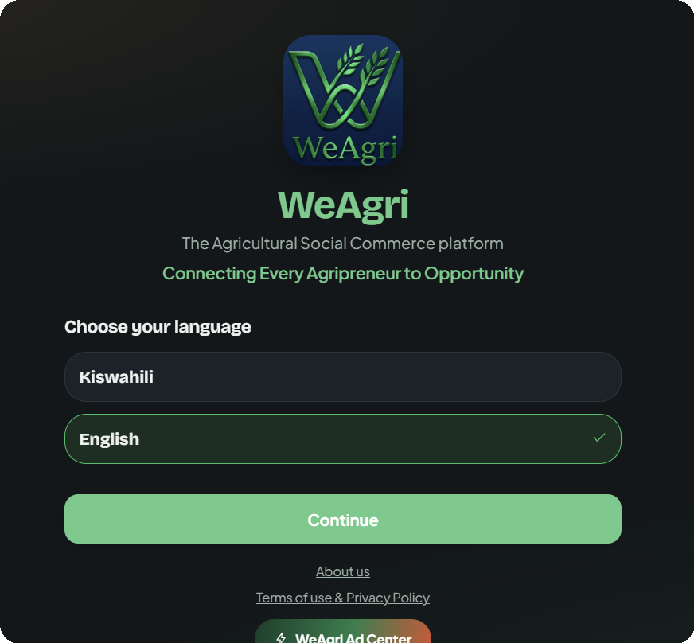




OVERVIEW
What is WeAgri?
WeAgri is a mobile app, social-commerce marketplace purpose-built for agriculture. It connects farmers, livestock keepers, buyers and agricultural doctors directly on one platform — in their own language, with verified identities, real-time order tracking, and a trust system built around points and ratings.
Sell directly — no middlemen
Real-time buyer ↔ seller chat
Onboarding in WeAgri — choose language, then country
QR + GPS order tracking
Swahili & English, built in
WeAgri · 02

Slide 3
THE PROBLEM
It is costs Tanzania millions
35M+
30%+
TZS 3.18T+
smallholder farmers across
United Republic of Tanzania lost food after post harvest.
of all food produced is lost
after harvest, every year.
lost annually to post-harvest
waste in Tanzania
Why this happens
Farmers sell blind — no visibility into real demand or fair prices nearby
Buyers can't verify who they're dealing with before sending money
No shared record of harvest timing, so produce rots waiting for buyers
Transport handoffs are untracked — packages and trust both go missing
Source:National Bureau of Statistics (NBS) — Annual Agricultural Sample Survey.
WeAgri · 03

Slide 4

OUR SOLUTION
One app, closing every gap.
Farmers sell blind
Live marketplace + Harvest Calendar — buyers see what's coming before it's even picked
No identity trust
Government-ID verification, badges, and a public seller-points & rating system
Produce rots unsold
Buyers get notified the moment a matching harvest is announced nearby
Deliveries go untracked
Auto-generated QR + live GPS tracking from pickup to confirmed delivery
WeAgri · 04

Slide 5





WHO IT'S FOR
Initial target users
Crop Farmers
Livestock Keepers
Buyers
Agricultural Doctors
Seed & Fertilizer Sellers
List produce, plan harvests, sell direct.
Number of initial target users 4 from Arusha in this category
Sell animals & dairy with verified trust.
Number of initial target Users 2 from Arusha in this category
Discover fresh, nearby, verified sellers.
Number of initial target users 7 from Arusha in this category
Offer consultations, build a client base.
Number of initial users is 2 from Arusha in this category
Reach farmers actively buying inputs.
Number of initial users is 1 from Arusha in this Category.
— same trust system, every market.
WeAgri · 05

Slide 6






INSIDE THE APP
Everything a real marketplace needs
Social Marketplace
Real-Time Chat
QR Order Tracking
Browse by crop, livestock, seed & fertilizer categories
Buyer and seller message directly, in-app
Every order gets a unique trackable ID
Live GPS Delivery
Harvest Calendar
ID Verification
Watch the package move, pickup to drop-off
Farmers announce harvests before they're ready
Government-ID badge for trusted sellers
Points & Ratings
Installable app
Swahili + English
Sellers earn points per completed, rated order
Iinstallable app from play store or App store
Fully bilingual, more languages on the roadmap
WeAgri · 06

Slide 7



Total initial cost
TZS350,000
TZS40,000
TZS60,000
For hosting the application
For internet bundle used in development
For the different software applications used in development of the app such as Resend JS API’s.
Therefore; The total cost of production is TZS 450,000
WeAgri · 19

Slide 8


REVENUE MODEL
Three engines. One marketplace.
WeAgri Ad Center
Post Boosting
Any seller can pay a flat, one-time fee to promote a single post — pushing it to the top of suggested buyers' feeds for maximum reach.
Monthly subscriptions for companies who want guaranteed visibility to farmers, livestock keepers, buyers, or agricultural professionals through ads— three tiers, billed monthly.
Initially Target companies are 5 companies in Tanzania.
TZS50,000 – TZS200,000
Pay-per-boost, self-serve
Based on specification such as coverage audience
Available to every seller, every listing
3% PER TRANSACTION
We earn from 3% of every User Transactions made.
10 transactions are expected to be completed per month.
1
WeAgri · 14

Slide 9
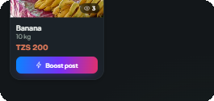

REVENUE STREAM 2
Post Boosting — monetization in every seller's pocket
Subscriptions serve advertisers and big players. Boosting serves everyone else: a single farmer with one great harvest can pay a small, flat fee to push that listing or post to the top of “most recommended” in buyers' feeds — the same instinct as boosting a post on Instagram.
Live from the app
No subscription required
Works for the smallest seller, not just paying advertisers
One tap, instant
The Boost button sits directly on every product card
“Boost post” — visible on every single product a seller lists
Self-serve revenue
Thousands of small transactions, not a handful of big ones
Flat fee per boost — set per country currency
Scales with the marketplace
More sellers and listings means more boosting volume
e.g. TZS 50,000 / boost in Tanzania
WeAgri · 16

Slide 10
WHO GAINS WHAT
Tailored value, by role
Farmers & Livestock Keepers
Buyers
Doctors & Input Sellers
Sell directly — keep the margin a middleman would take
Discover fresh, nearby, ID-verified sellers
Reach the entire active farming community at once
Plan harvests around real, pre-confirmed demand
Track every order live, from pickup to delivery
Turn consultations and seed/fertilizer sales into repeat business
Build a public reputation that compounds over time
Pre-book upcoming harvests before they sell out
Advertise directly to the audience that needs them
WeAgri · 18

Slide 11
MARKET TIMING
Why this works now
45%
751M
TZS 7.4T - 8.5T
Of smallholder farmers using smartphones across
Tanzania today.
projected mobile subscribers
by 2030 (GSMA)
projected annual contribution
of mobile to Tanzania GDP by 2030
Three forces converging at once
Connectivity is no longer the blocker — mobile internet usage keeps climbing year over year
Mobile money (M-Pesa, Airtel Money, Mixx) already handles everyday payments across the region
Smallholder agriculture is still mostly offline — the largest underserved sector left to digitize
Source: TCRA, The Tanzania Communications Regulatory Authority
WeAgri · 19

Slide 12



Real farmers. Real buyers. Real trust.
WeAgri turns Africa's largest, least-connected workforce into a trusted digital marketplace —
with a revenue model that grows the same way the platform does: one seller, one boost, one subscription at a time.
33M+ smallholder farmers waiting to be reached
7 countries live, same playbook for the next 7
Three revenue engines, already built and working
Thank you
weagri.app @swervetechcompany

